Slide 1


By: RINAE Apps™
Date: 04 February 2022

Slide 2

Meet the Team
Nokulunga Twala
Rinae Tshivhidzo
Kwanda Mazibuko
Tsepo Sehaole
Tshegofatso Sekgobela

Slide 3
Content
Introduction
Problem statement
Exploring the Data
Machine Learning
App development
Conclusion

Slide 4

Introduction

Slide 5
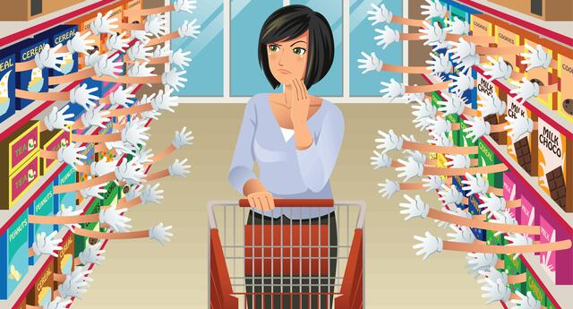

Slide 6


Slide 7
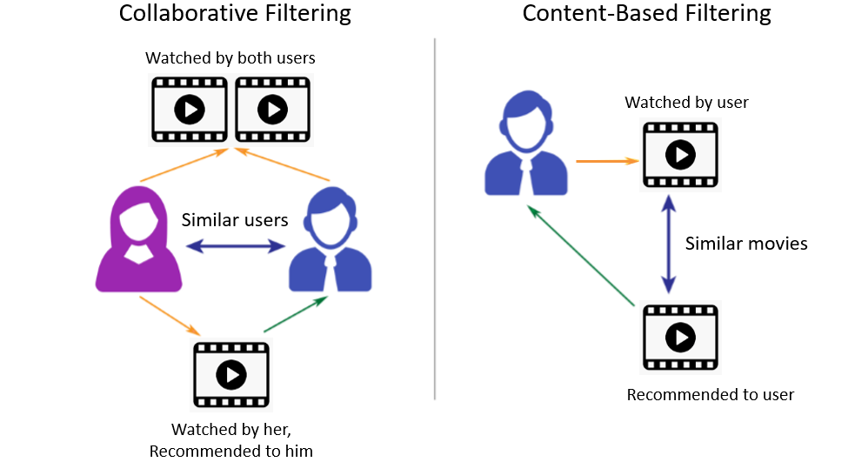

Slide 8

Problem Statement

Slide 9
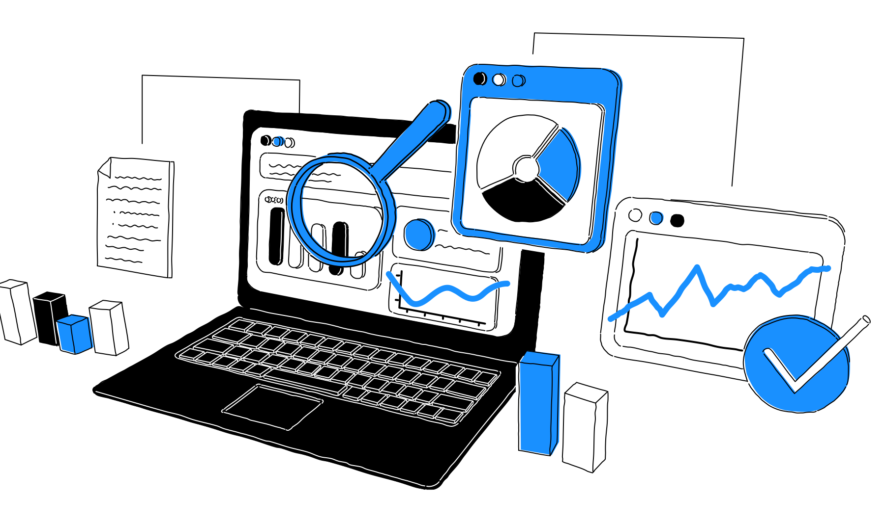
Understanding data

Slide 10
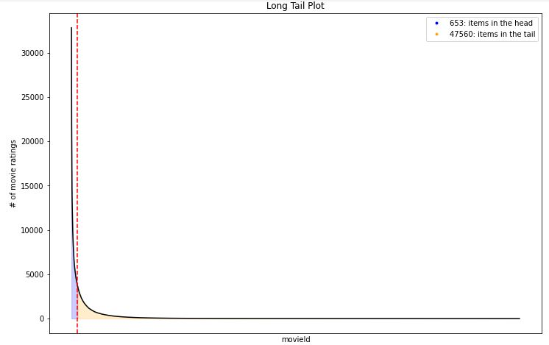
Popular Movies
653 popular movies and 45760 unpopular movies.

Slide 11
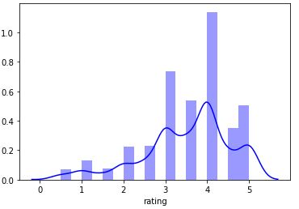
Ratings by Movie Users
Most movies received ratings of 4, while others received less

Slide 12
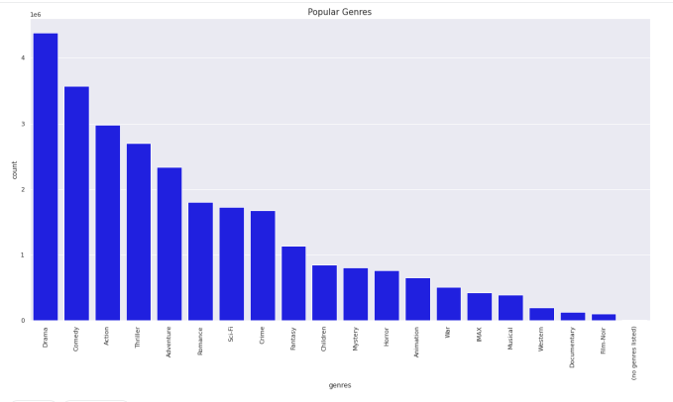
Popular Movie Genres
Drama, Comedy and Thriller are top 3 most common movie genres.

Slide 13
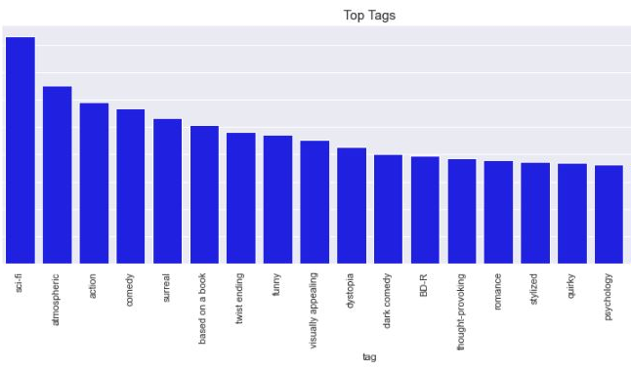
Popular Movie Tags
Sci-fi is the most popular tag while classic has the least number of counts.

Slide 14
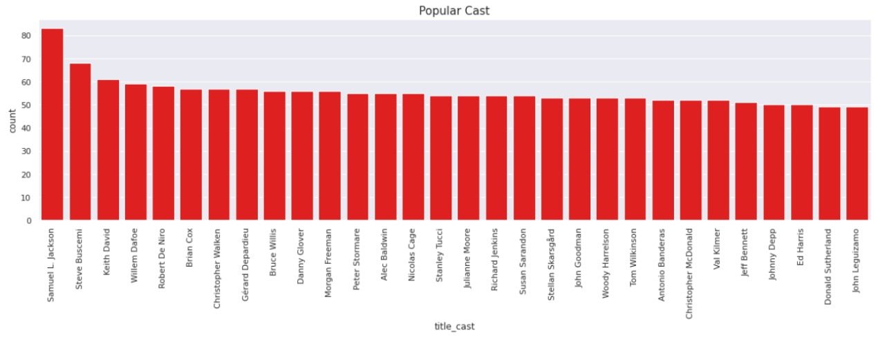
Popular Cast Members

Slide 15
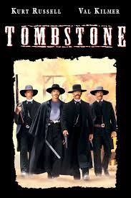
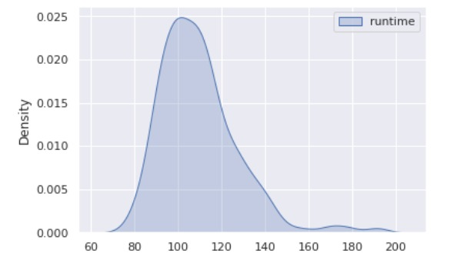
Movie Runtime

Slide 16
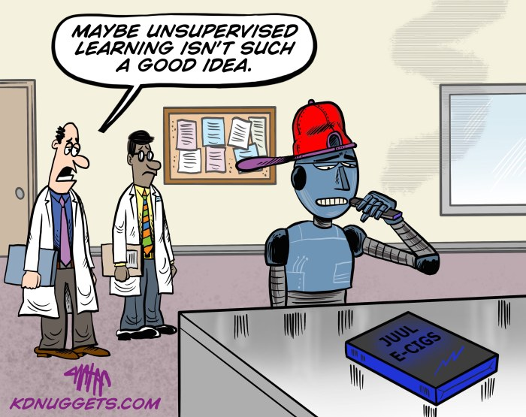
Machine Learning

Slide 17
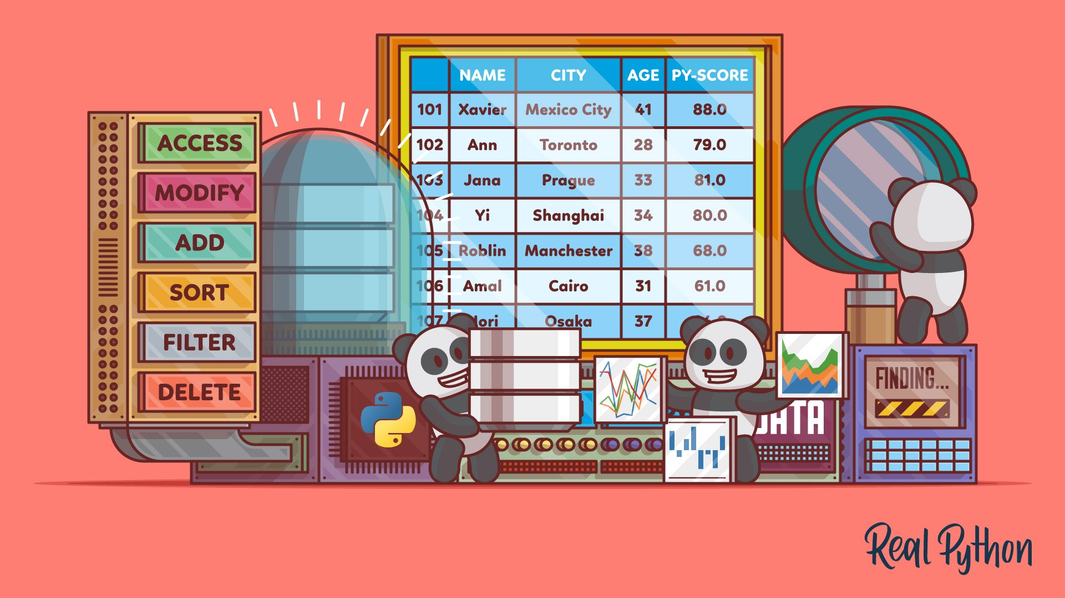
Preparing our data
Data cleaning
Dealing with missing values
Engineer new features

Slide 18
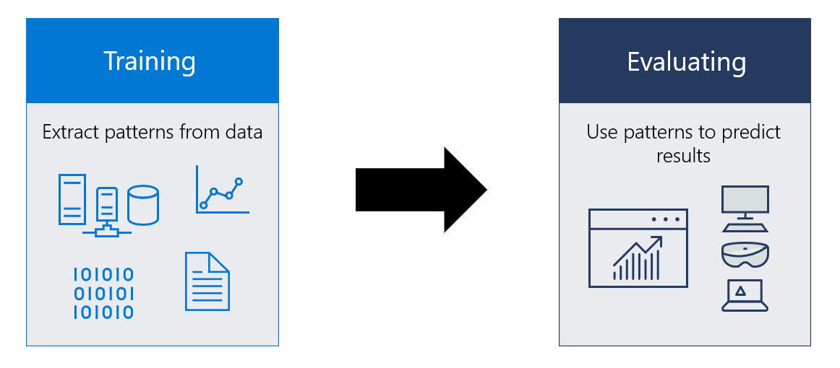
Modeling

Slide 19

App Development

Slide 20


Slide 21
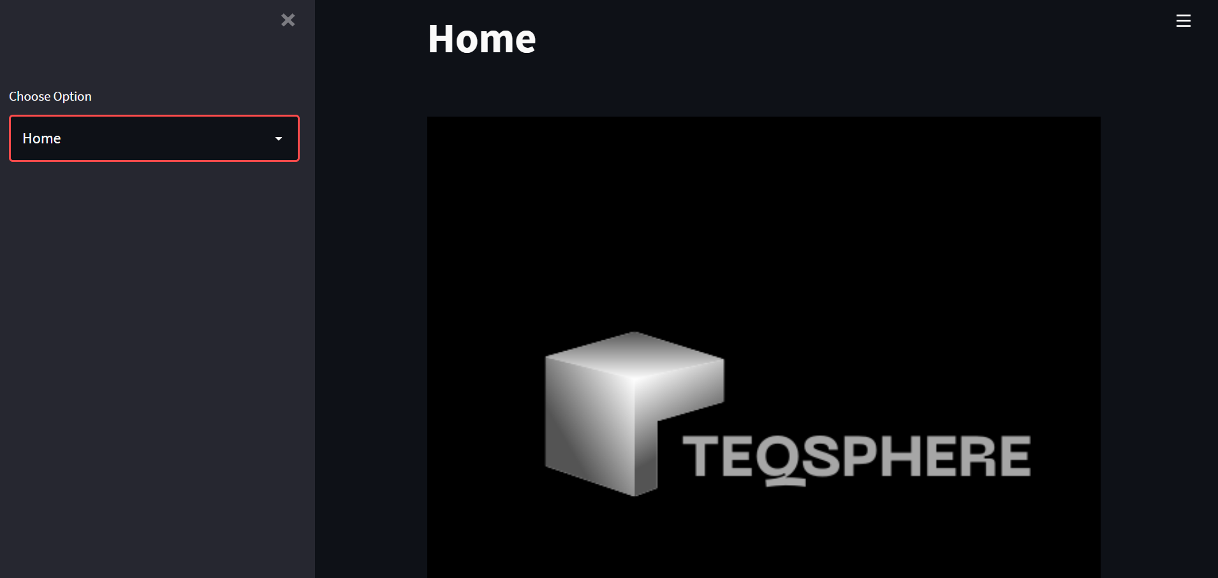
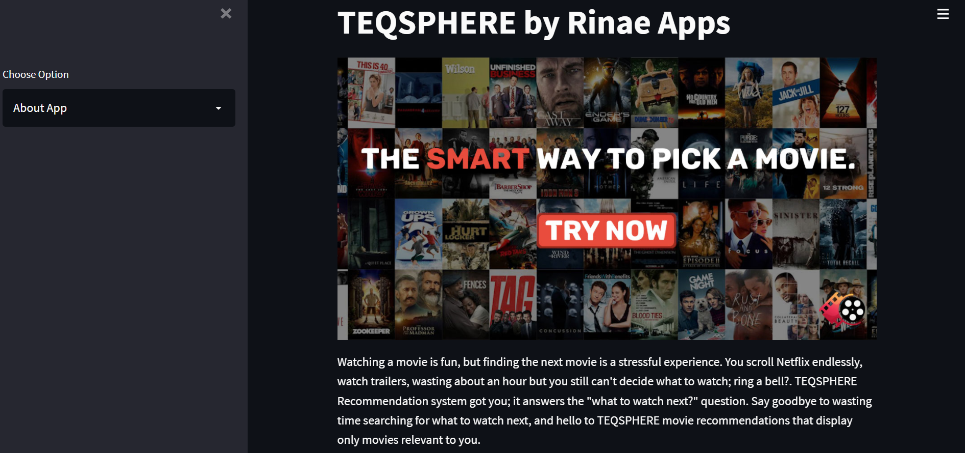
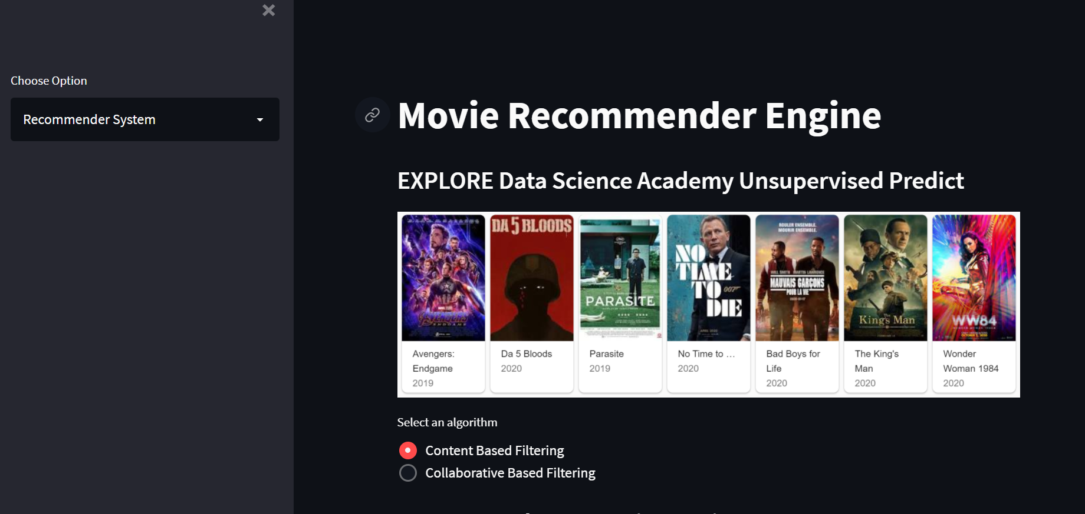
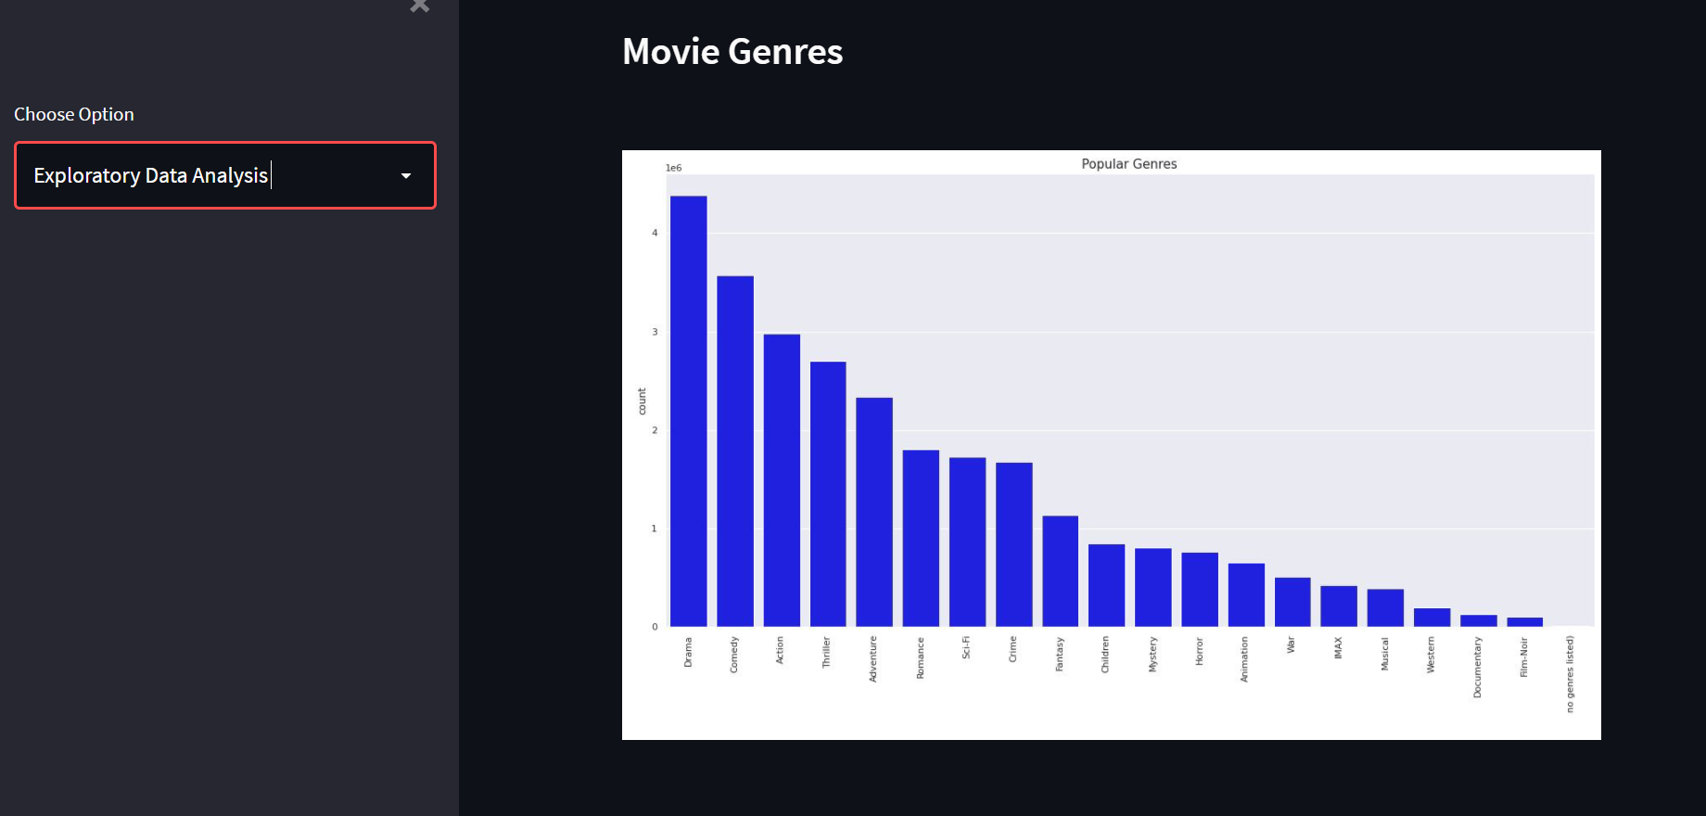

Slide 22
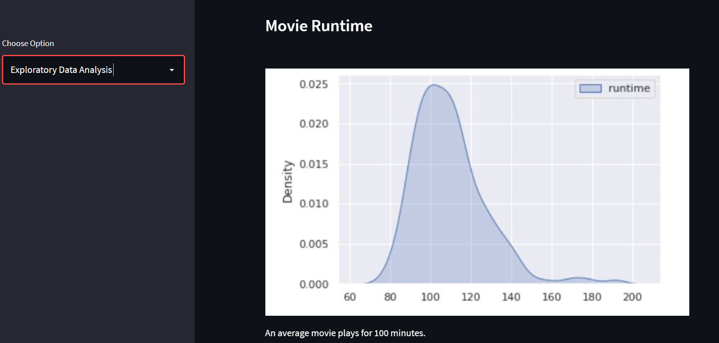
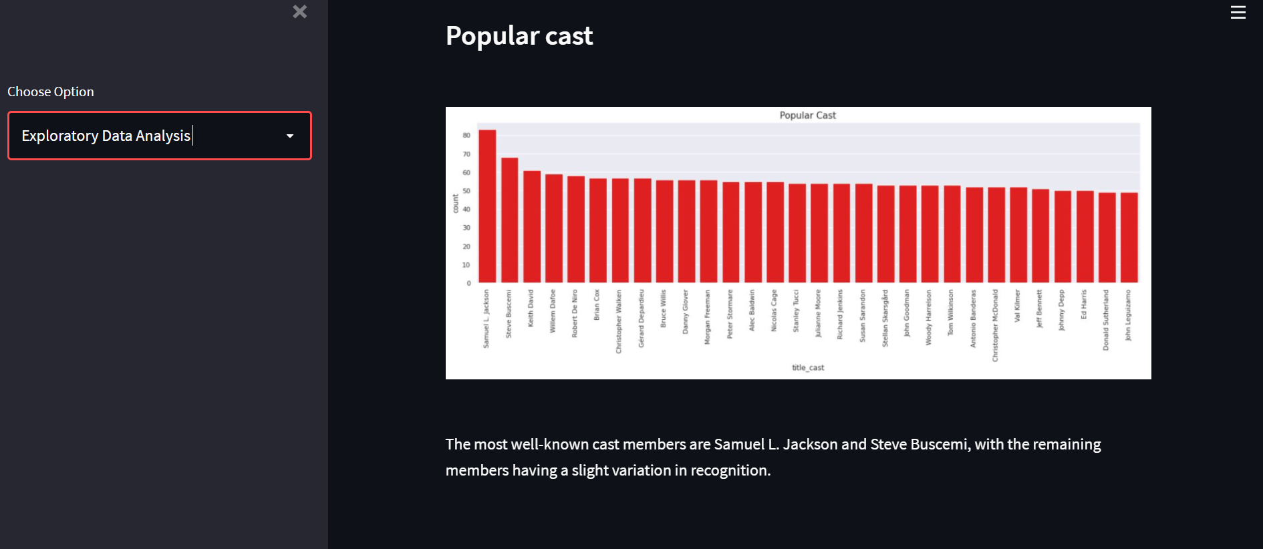
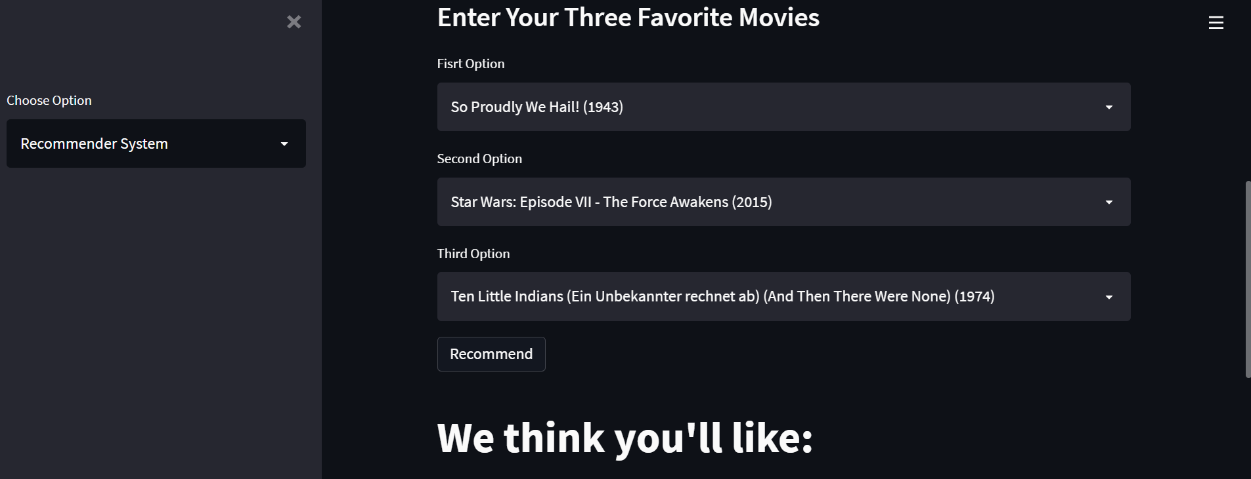
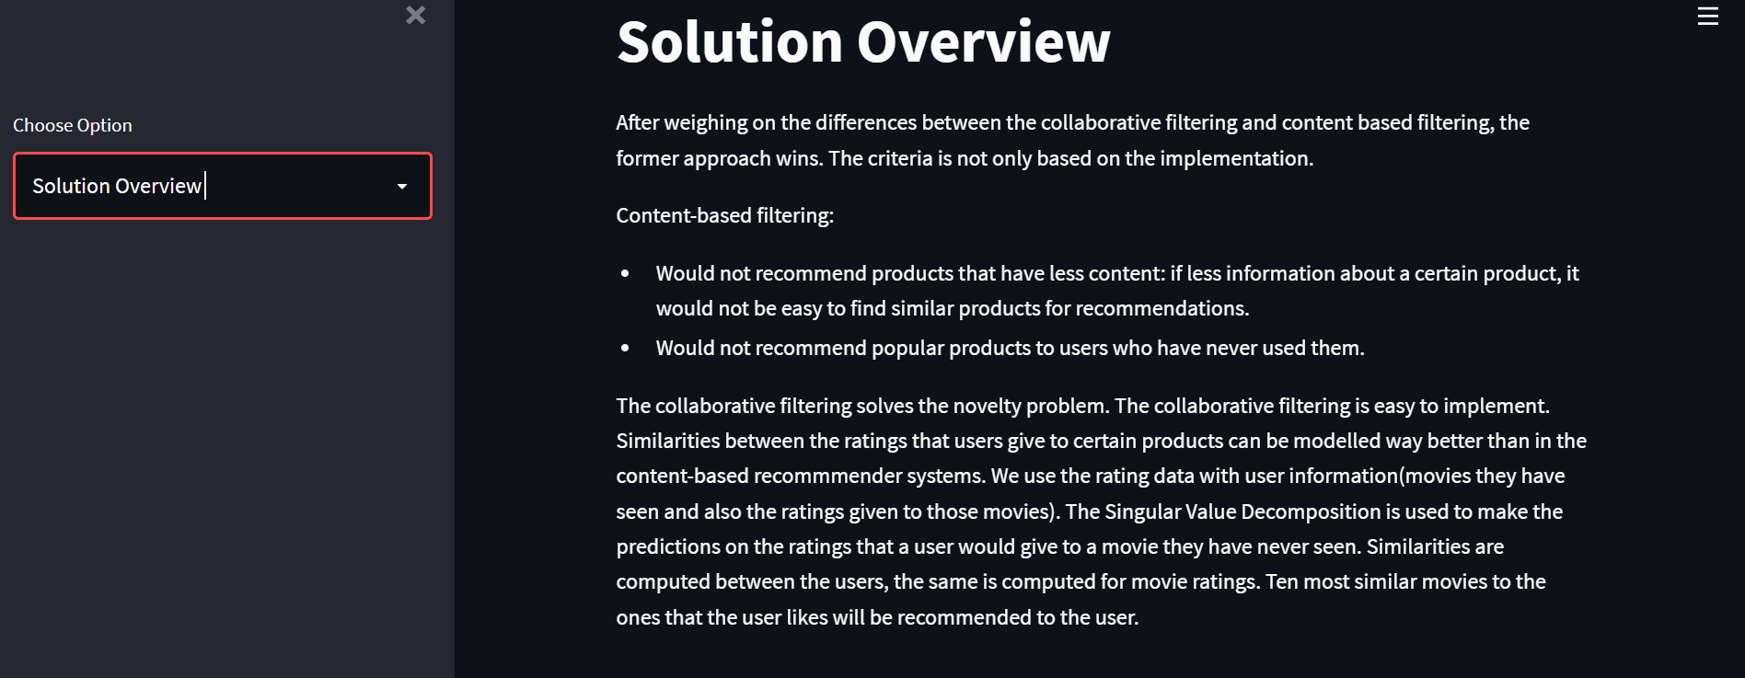

Slide 23
Conclusion

Slide 24

Thank You

